Slide 1
NoSQL DATABASES

Slide 2
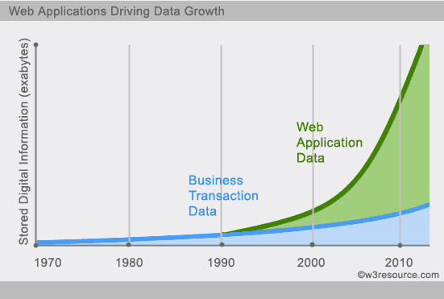
The limitations of RDBMS
Scalability: Not good for large volume (PB) of data
Complexity: Not good with variety of data types (images, audio and video).
performance issues : As a database grows in size or the number of users multiplies, many RDBMS suffer serious performance issues.
Schema evolution (RDBMS schema migration is not trivial at large scale).
Database administration: Best RDBMSs require the services of expensive administrators to design, install and maintain the systems.
Its inadequacy to operate with languages outside of SQL.

Slide 3
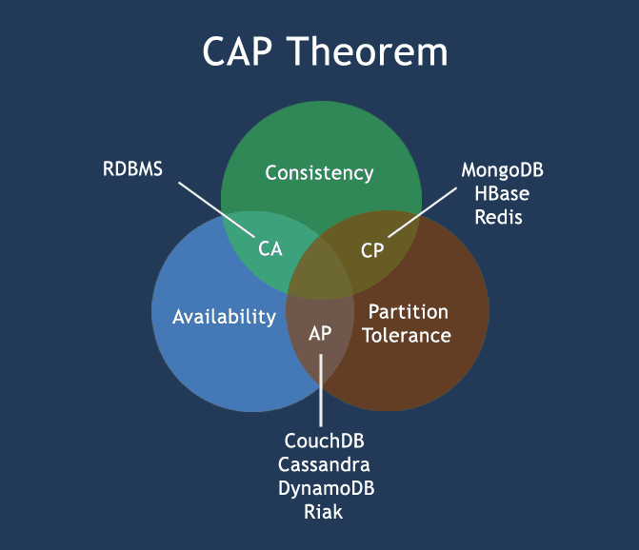
CAP Theorem (Brewer’s Theorem)
Consistency - Database remains consistent after the execution of an operation.
Availability - This means that the system is always on (service guarantee availability), no downtime.
Partition Tolerance - It represents the fact that a given system continues to operate even under circumstances of data loss or system failure. A single node failure should not cause the entire system to collapse.

Slide 4
NOSQL
What is NoSQL?
NoSQL is a non-relational database management systems, different from traditional relational database management systems in some significant ways. It is designed for distributed data stores where very large scale of data storing needs. These type of data storing may not require fixed schema and typically scale horizontally.
Why NoSQL?
Personal user information, geographic location data, user-generated data and text, machine-logging data, sensor-generated data, and satellite images are just a few examples of the ever-expanding arrays being captured, to process huge amount of data. Which SQL databases were never designed. The evolution of NoSql databases is to handle these huge data properly.
Enterprises are also relying on Big Data to drive their mission-critical applications. Organizations are turning to NoSQL databases because they are uniquely suited for these new classes of data emerging today.

Slide 5
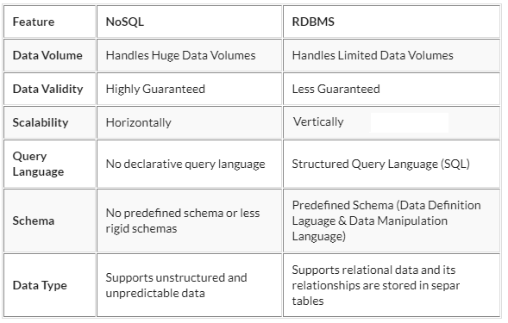
Key Characteristics of NoSQL Databases
compatibility factor with cloud computing
Scalability
Commodity hardware
Flexibility (provides schema flexibility and less complicated relationships unlike in RDBMS.)
Limitations of NoSQL Databases
Enterprise Support
Expertise
ACID Properties

Slide 6
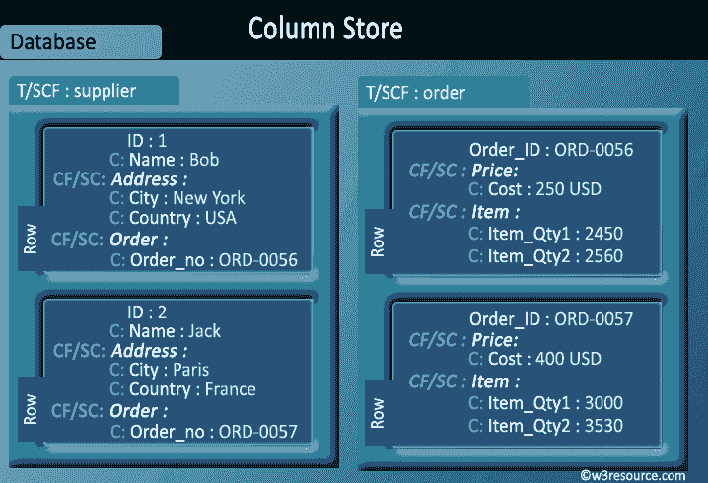
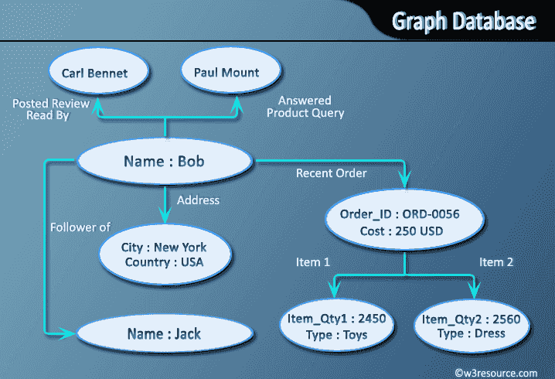
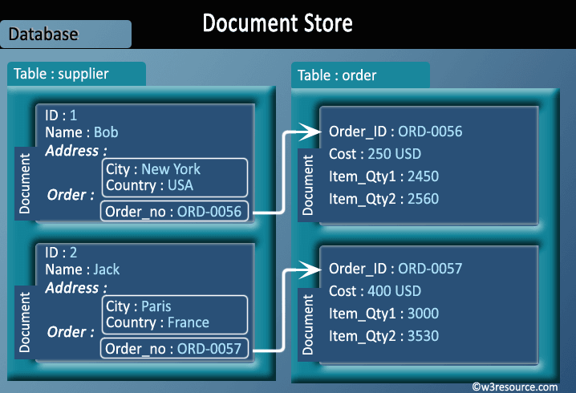
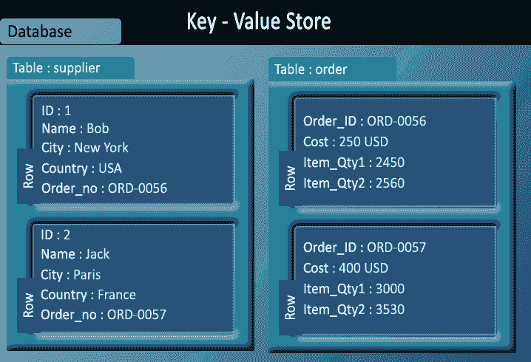
HBase, Cassandra etc
OrientDB, Neo4J, Titan etc
MongoDB, CouchDB etc
Redis, Dynamo, Riak etc

Slide 7
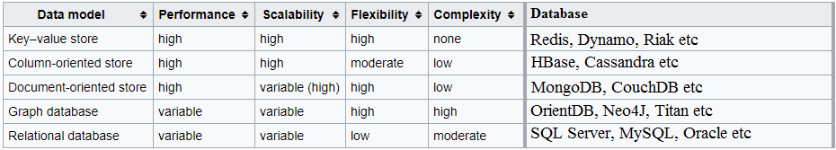
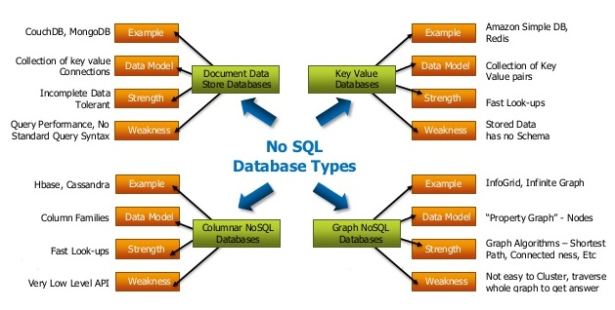
Data Model Comparison

Slide 8
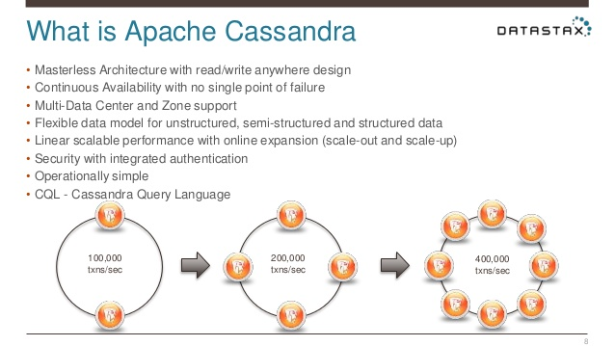
Apache Cassandra
The architecture of Cassandra is “masterless”, meaning all nodes are the same.
All nodes communicate with each other via a gossip protocol.
Cassandra's distribution design is based on Amazon's Dynamo and its data model on Google's Bigtable.

Slide 9
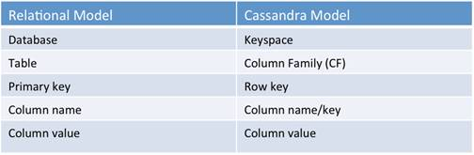
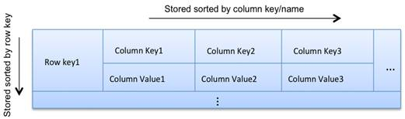
Main Features
Decentralized Every node in the cluster has the same role.
Rigid Architecture there is no single point of failure.
Supports replication and multi data center replication.
Scalability Read and write throughput both increase linearly as new machines are added, with no downtime or interruption to applications.
Fault-tolerant
Schema-free, eventually consistent.
Cassandra has Hadoop integration, with MapReduce support.

Slide 10
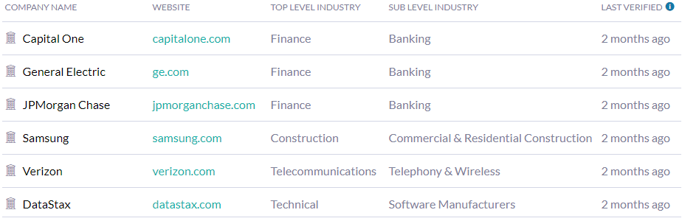
Companies using Cassandra
Limitations of Cassandra
Sub-millisecond consistency.
Cassandra does not support rollback or locking mechanisms.
Unpredictable Performance.

Slide 11
CouchDB
CouchDB is an open source NoSQL database developed by Apache software foundation. It is written in Erlang programming language.
Data is stored in the flexible document-based structure.
HTTP requests are used to communicate with CouchDB, By using these requests,
Retrieve data from the database.
Store data in to the database in the form of documents.
View as well as format the documents stored in a database.
There are different request formats used with Database while communicating. These request formats are:
Get
Head
Post
Put
Delete
Copy

Slide 12
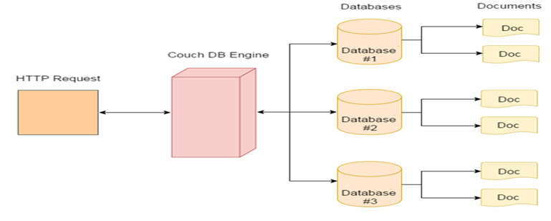
CouchDB Data Model & Architecture
Each database is a collection of independent documents.
Each document is responsible for maintaining its own data and self-contained schema.
Document metadata contains revision information, which makes it possible to merge the differences occurred while the databases were disconnected.
HTTP requests are used to communicate with CouchDB, JSON for data storage.
Compatible to all platforms.

Slide 13
Main features
Distributed Architecture with Replication
Document Storage (CouchDB stores data in JSON document.)
Schema-Free
Browser Based GUI
Replication Filters: CouchDB facilitates you to filter precisely the data you wish to replicate to different nodes.
It follows AP in CAP theorem.
Eventual Consistency
CouchDB is map/reduce system.
Programming model / Connectivity
CouchDB provides client libraries for different programming languages such as Java / PHP / Python / Node.js

Slide 14
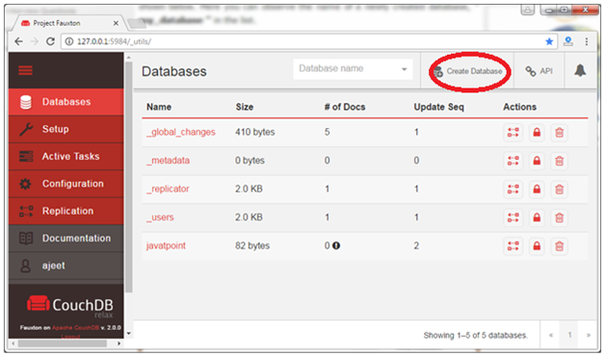
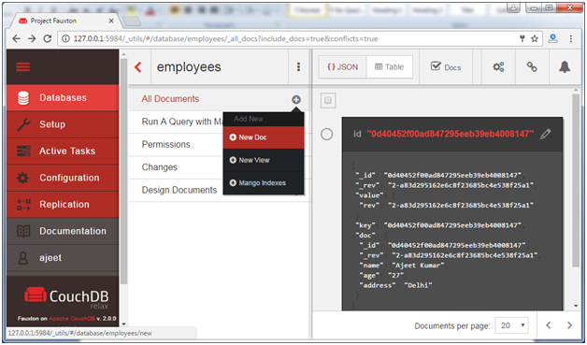
There are two ways to communicate with CouchDB:
CouchDB cURL
CouchDB Fauxton
CouchDB Fauxton
It s a web based built-in administration interface. It is very simple to use. It provides a simple graphical interface to interact with CouchDB. It provides full access to all CouchDB features.
To start http://127.0.0.1:5984/_utils/
Create a database
Create a new document

Slide 15
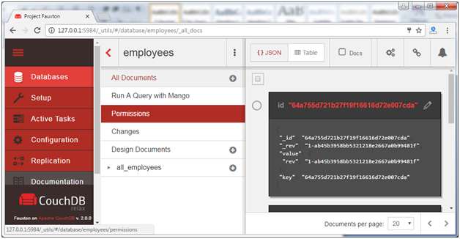
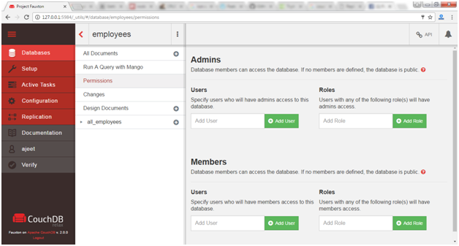
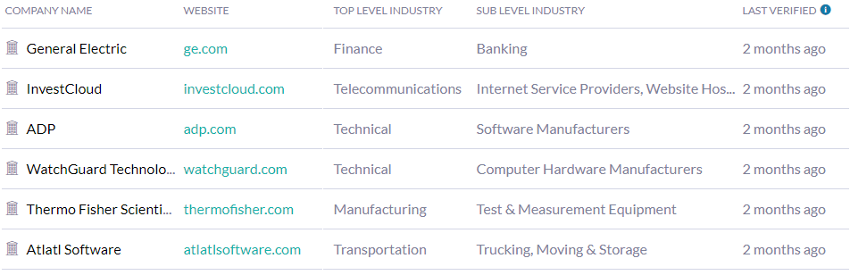
Permissions related activities
Companies using CouchDB

Slide 16
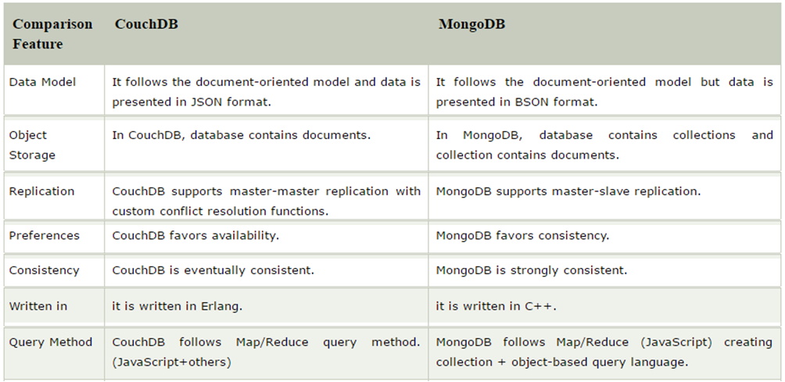
Comparison

Slide 17
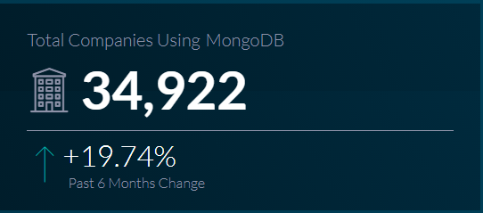
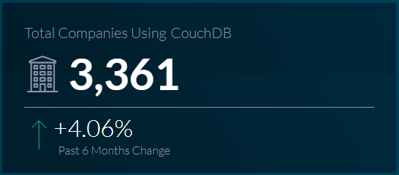
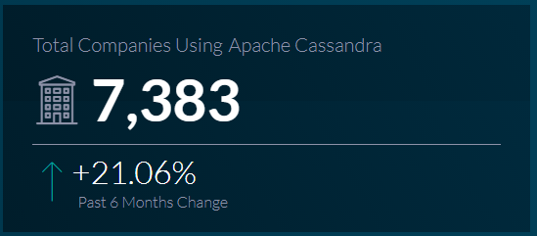
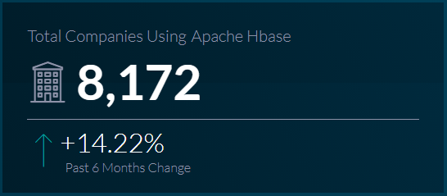
Market Share

Slide 18
THANK YOU

